Slide 1
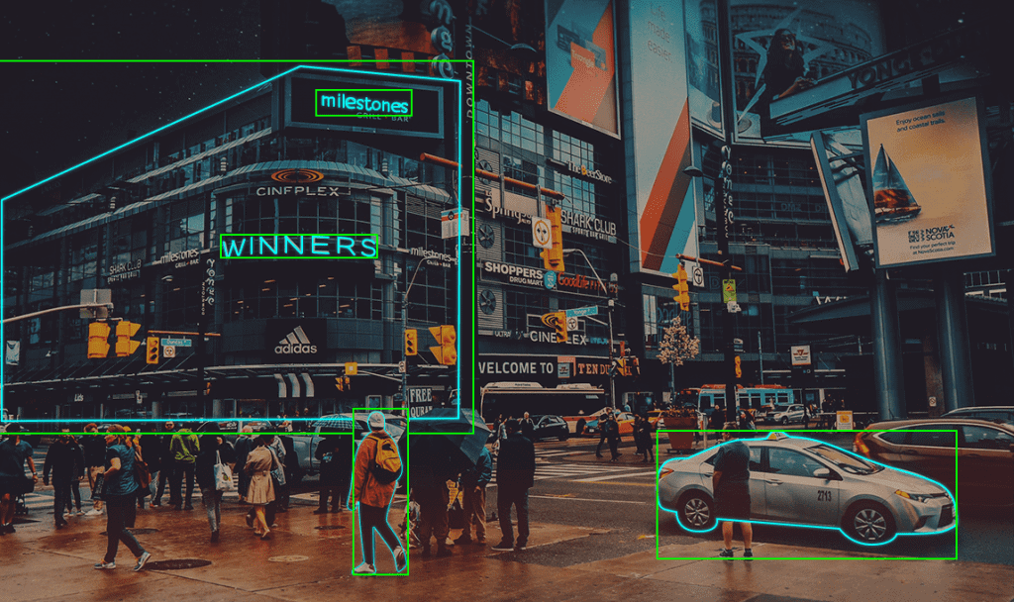

Introduction to Computer Vision
Minh Anh & Jun Yong

Slide 2


Slide 3


Slide 4
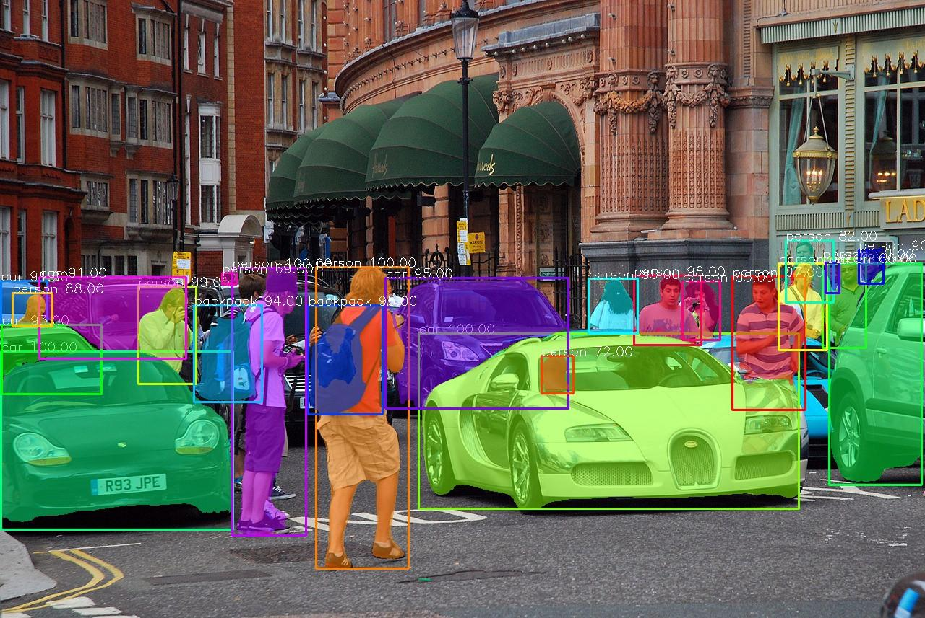
Overview
01
What is computer vision (Tasks, Artificial Neural Network etc)
02
Convolutional Neural Network
03
Image Classification in Google Collab!

Slide 5
Aims and Scope of Workshop
Participants should ideally have:
Basic python programming knowledge
Basic knowledge of Machine Learning
Basic idea of Neural Networks
Goals for this Workshop is for participants to:
Understand the types of problems that Computer Vision tackles
Understand the basic theory of Convolutional Neural Networks (CNN)
Implement image classification in Google Collab

Slide 6
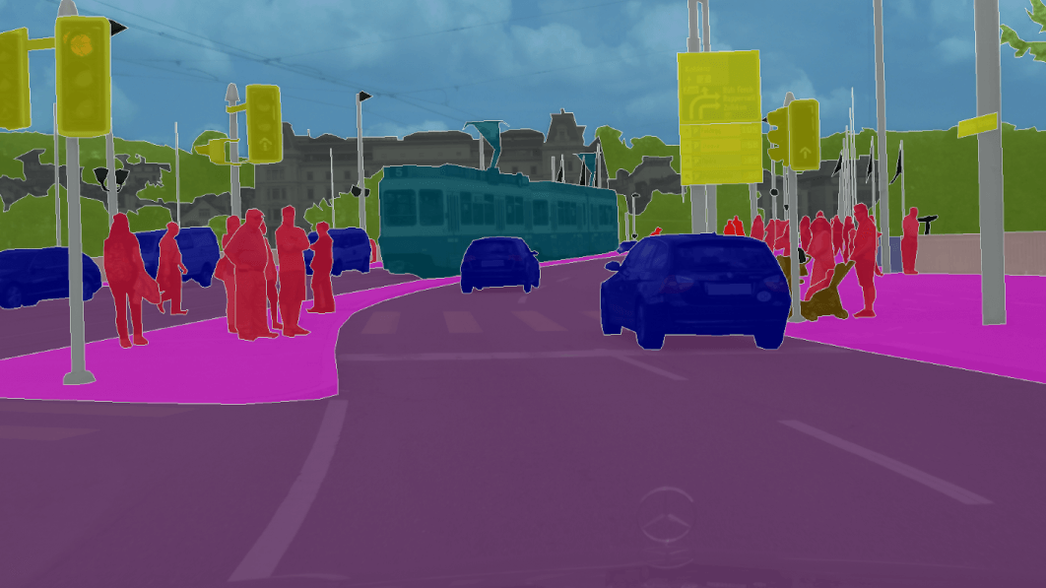
Try to Answer those questions at the end of day
HOW DO OUR BRAINS WORK?
HOW DO CNN WORK?
HOW DO THEY SCAN IMAGES?
WHAT ARE THE STEPS THAT CONSTITUTE THE CNN'S PROCESS?

Slide 7
Computer Vision
Notes:
Classification of five classes flowers:
https://colab.research.google.com/github/tensorflow/docs/blob/master/site/en/tutorials/images/classification.ipynb#scrollTo=dC40sRITBSsQ

Slide 8
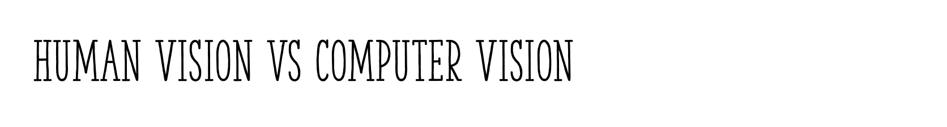
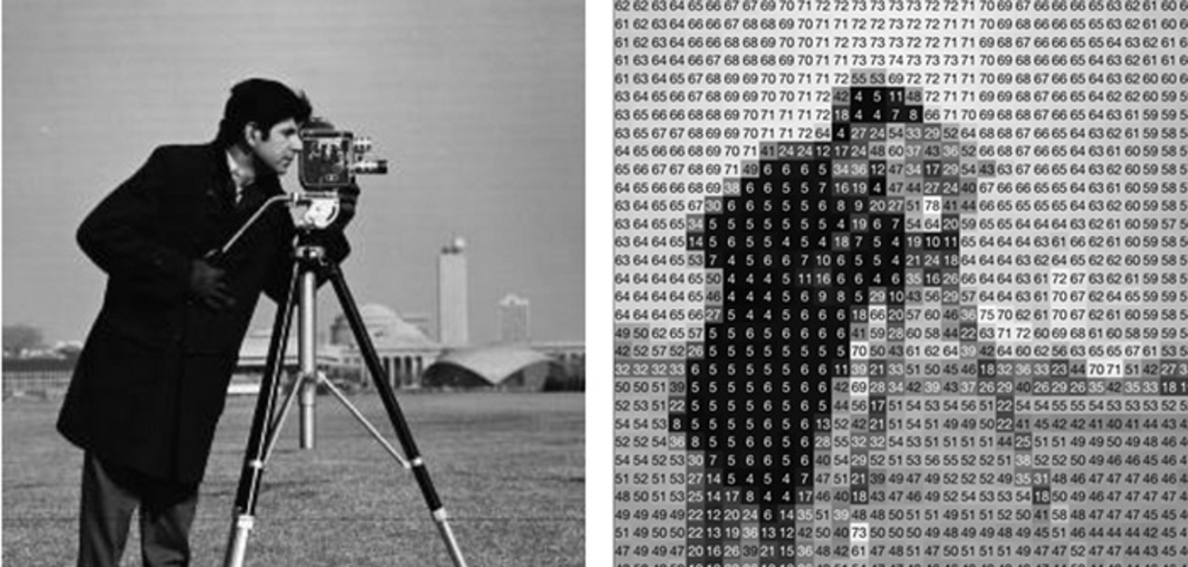

Slide 9
Type of Computer Vision Tasks

Slide 10
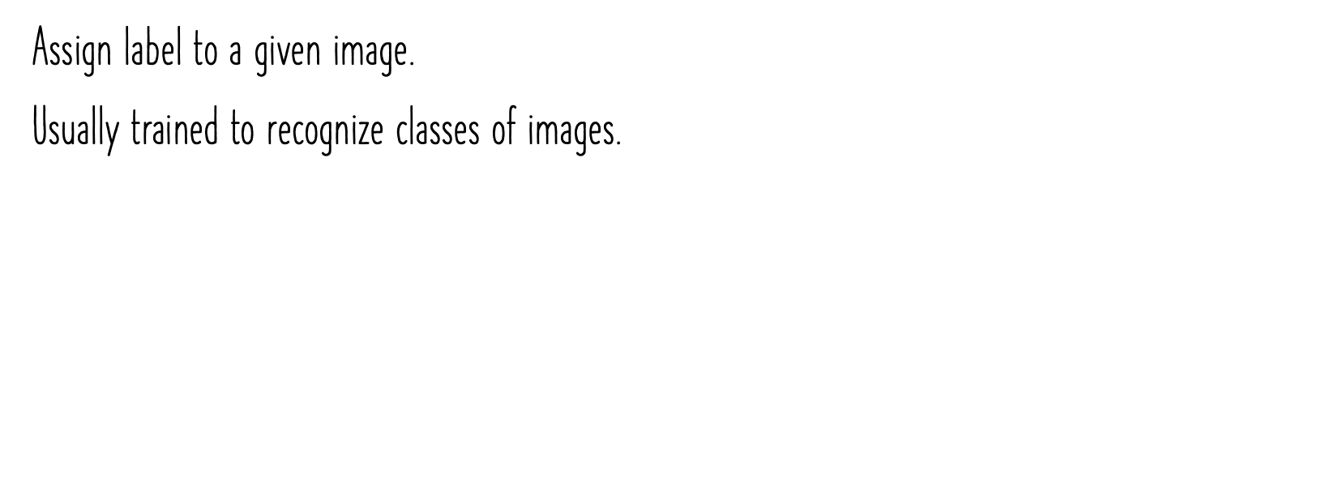
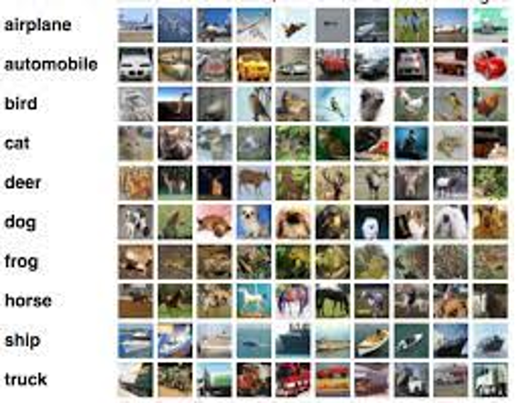

RGB image

Slide 11
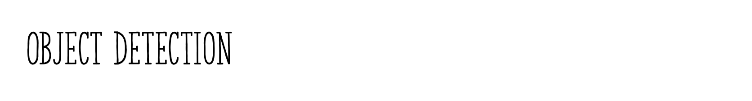
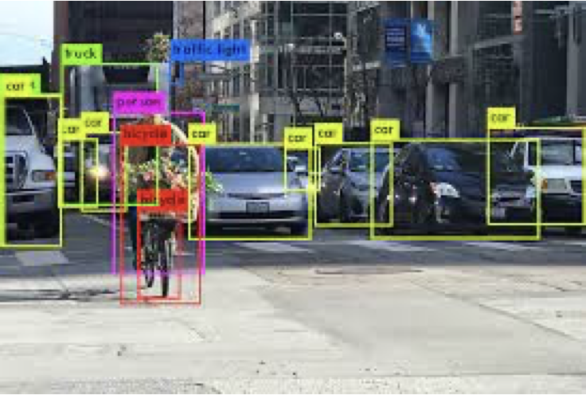
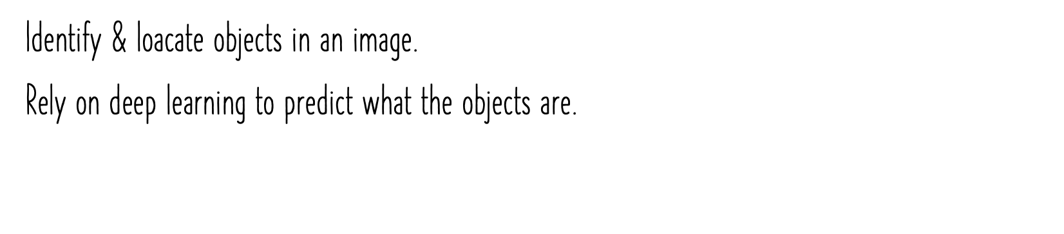
Matrix of pixels with a given Width (W), Height (H), and Channel (C)
Channel Grayscale image channel = 1
RGB image channel = 3
RGB image

Slide 12
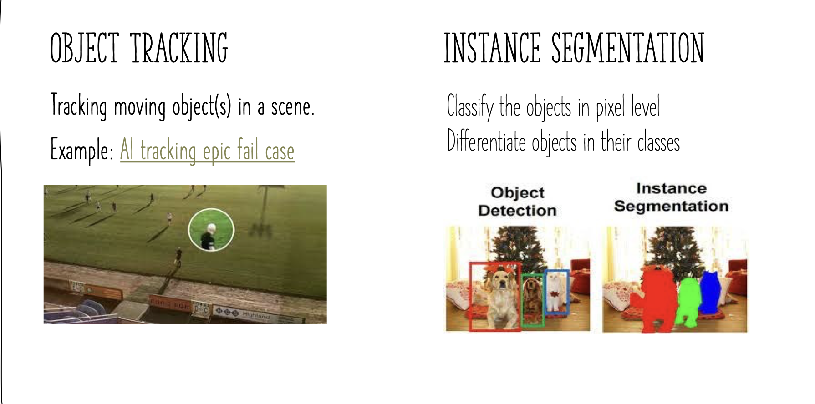

Slide 13
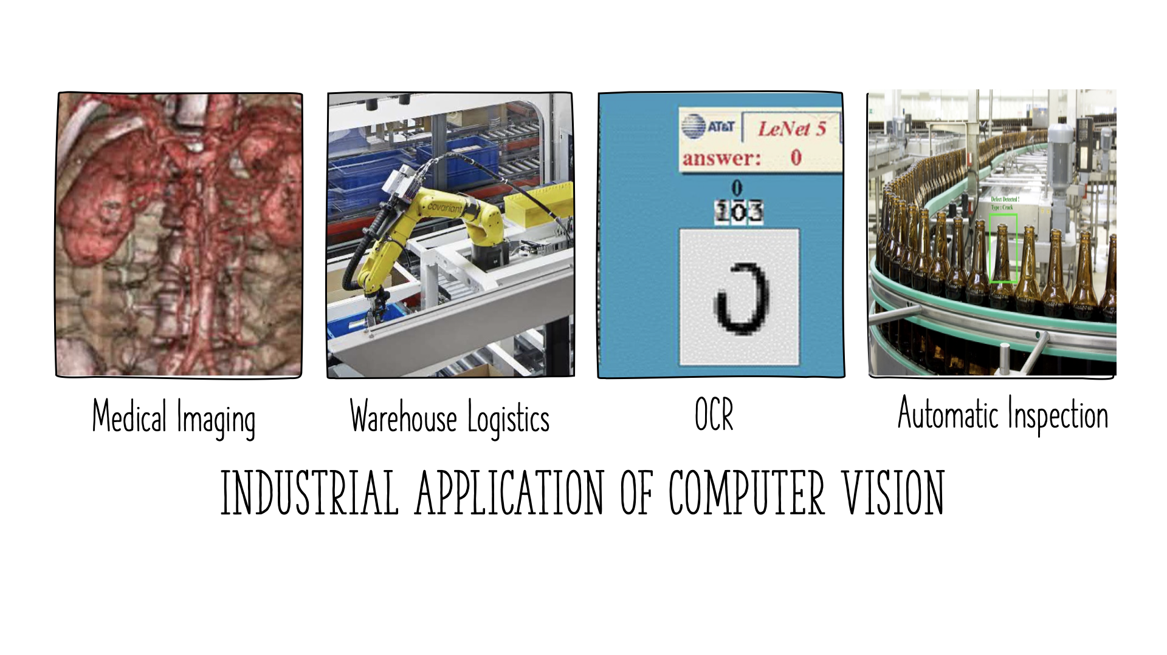
Notes:
Medical imaging: registering pre-operative and intra-operative imagery or performing
Warehouse logistics: autonomous package delivery and pallet-carrying “drives”
Optical character recognition (OCR): reading handwritten postal codes on letters
Last one: define crack item

Slide 14
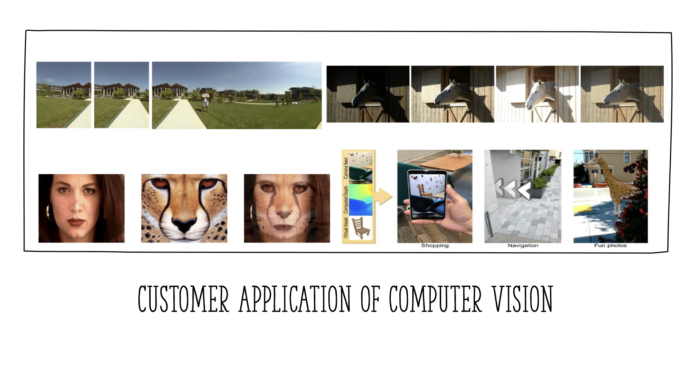
Notes:
image stitching: merging different views
exposure bracketing: merging different exposures
morphing: blending between two photographs
Smartphone augmented reality showing real-time depth occlusion effects

Slide 15
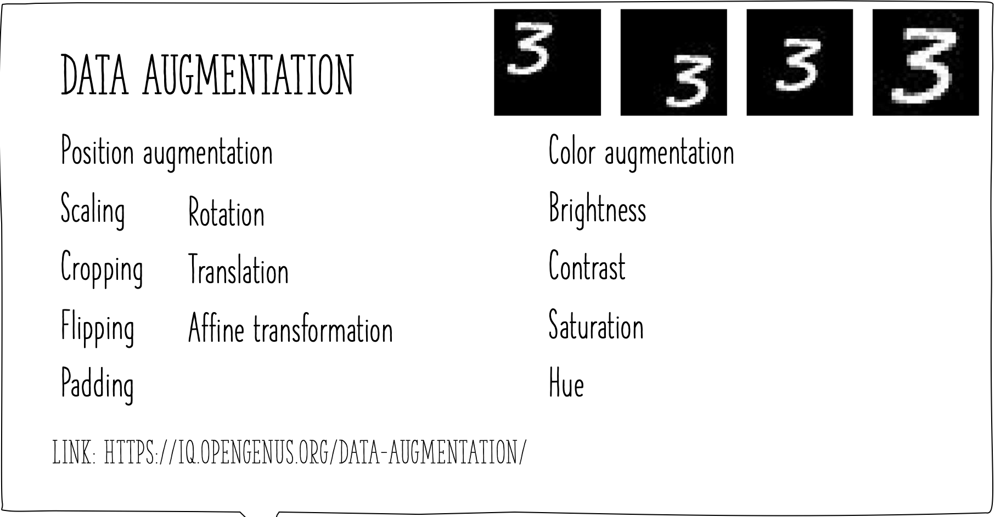
Notes:
this is for image processing, cv to increase diversity and amount of training data by applying random transformation.

Slide 16
2. Convolutional Neural Network (CNN)

Slide 17
What is Deep Learning
Deep Learning is the most exciting and powerful branch of Machine Learning. Deep Learning models can be used for a variety of complex tasks:
Artificial Neural Networks for Regression and Classification
Convolutional Neural Networks for Computer Vision
Recurrent Neural Networks for Time Series Analysis
Self Organizing Maps for Feature Extraction
Deep Boltzmann Machines for Recommendation Systems
Auto Encoders for Recommendation Systems

Slide 18
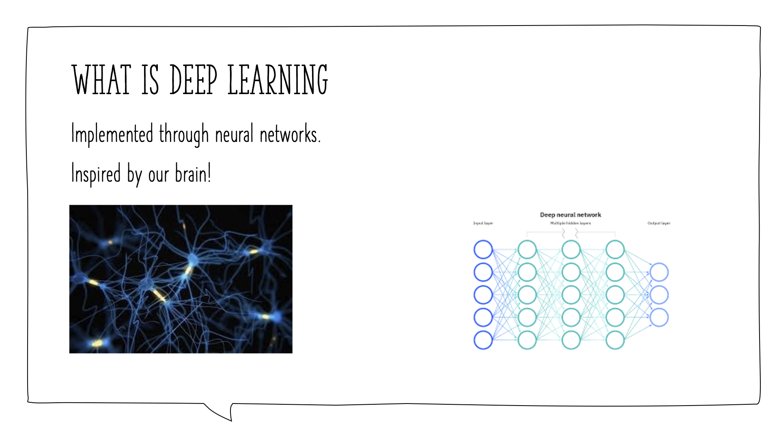
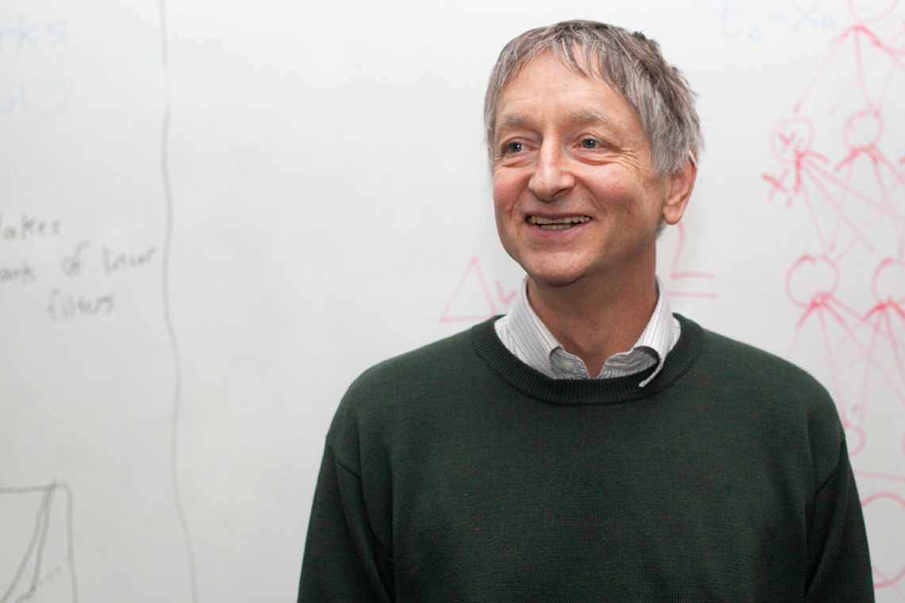
Geoffrey Hinton
Notes:
Deep Learning is a subfield of machine learning concerned with algorithms inspired by the structure and function of the brain.
Geofrey Hinton, he is known as god father of deep learning and he did research on DL in 80s and hv public lot of paper in DL and he work as google and u can check his video explaining, pretty well.
And the idea behind DL is to look at the human brain and this a little bit of neuroscience coming up and what is trying to do is to mimic how the human brain operates. Well because human brain seems to be one of the most powerful tools on this planet for learning, apapting skills and applying them. And if computers could copy that, then we could leverage what natural selection has already decided
As you see this is the neurons and this have like a body, branches and have like tails and so on, and u see they hv nucleus in side them and that’s basically what a neuron looks like in the human brain & there are 100 billion neurons in the human brain and each neuron is connected as a thousand of its neighbour
Well then we create an artificial structure call ANN where we have nodes or neurons

Slide 19
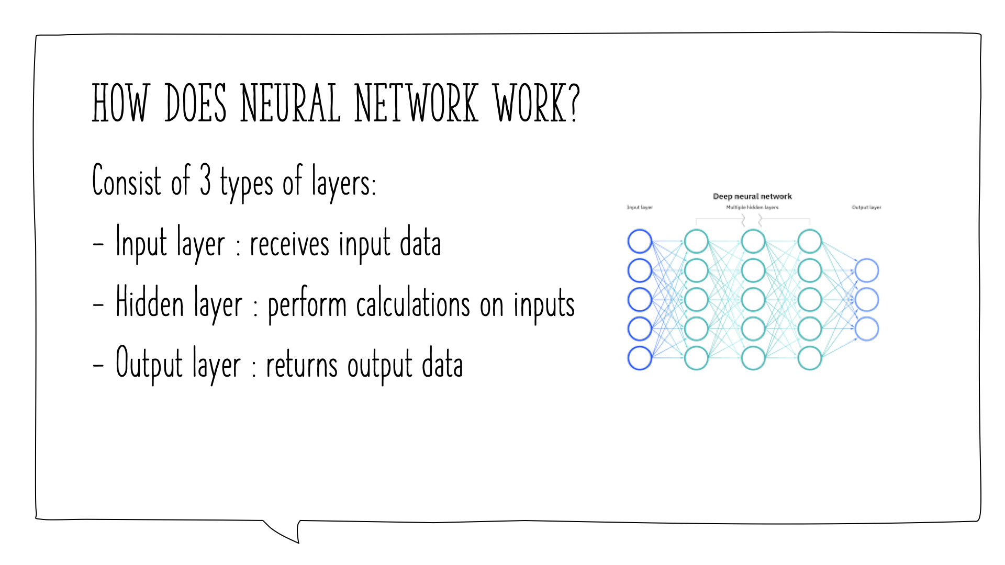
Continuos
Binary
Categorical
Notes:
And we hv some neurons for input values so these are values that you know abt certain situation. So, for instance, you’re modelling sth, you want to predict sth, u are going to hv some input, sth to start your predictinons off. Then that’s called the input layer
Then u hv the o/p, that’s the value that you want to predict or whether it’s surprise whether it’s somebody going to leave the bank or stay in the bank is this a fraudulent transaction or real and so on and that’s going to be an o/p layer. O/p can be continuos (price)
Binary (yes/no)
Categorical. And 1 thing to rmb is that your o/p valye won’t be j one. It’ll be several o/p values because these will be dummt variables which will representing your categories and that’s how u get out of the ann
And between we’re going to hv a hidden layer. As you see in your brain, u hv so many neurons and so some information is coming in thru your eyes, ears and nose, basically your senses. And then its not going right away to the o/p where u hv. The result is going thru all of these billions and billion of neuron before it gets to the o/p and this is the whole concept behind it that we’re going to model the brain so we need those hidden layers that are before the o/p. so the i/p layers, neuron connected to the hidden layer neurons and the hidden layer of neurons that connected to o/p value and this is pretty cool but where is the deep learning here? well it’s further and not just 1 hidden layers but lots and lots of hidden layers and then we connect everything, just like a human brain. We connect everything, interconnected everything. And that’s how the i/p values are processed thru all these hidden layers, j like in human brain
Deep learning is a class of machine learning algorithms that uses multiple layers to progressively extract higher-level features from the raw input. For example, in image processing, lower layers may identify edges, while higher layers may identify the concepts relevant to a human such as digits or letters or faces.

Slide 20
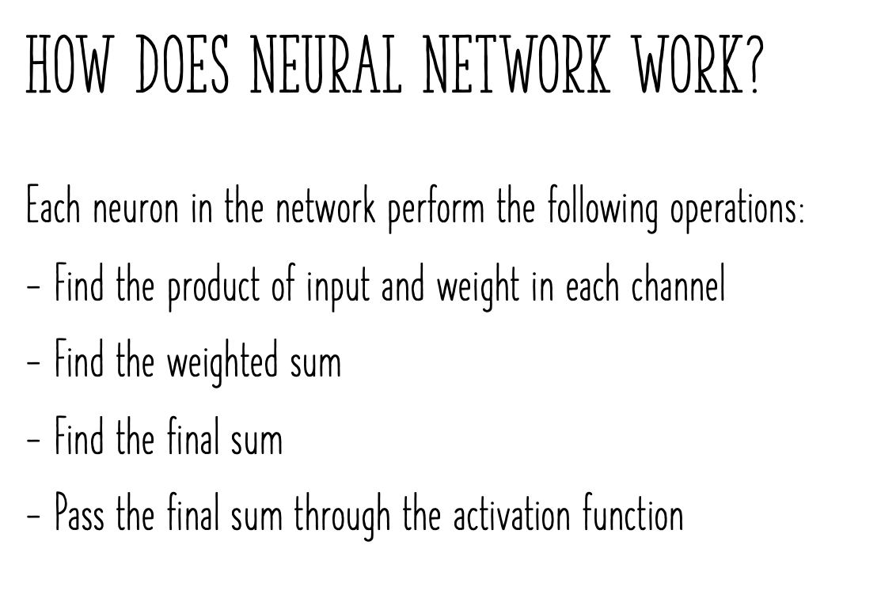
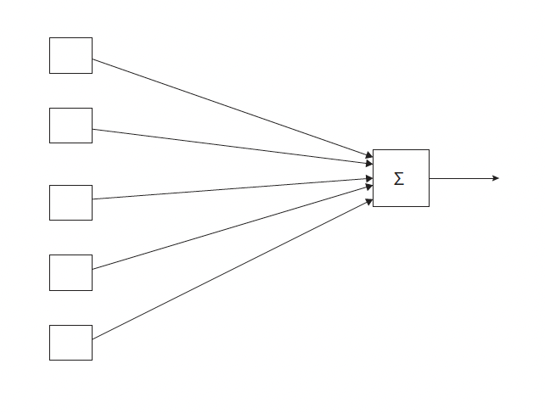
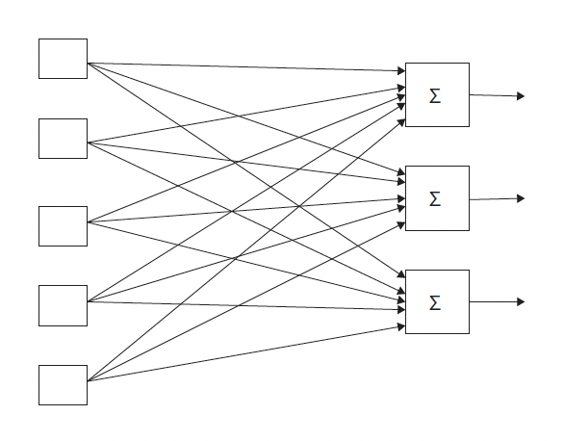
Weights, w
Additional Reading: Deep Sparse Rectifier Neural Network by Xavier Glorot v.v
output
Notes:
So next thing I want to talk abt is that here sunapese get assigned weights. In short, weights are crucial to ann function because the weights are how NN learn. By adjusting the weights, the nn decides in every single case what single signal is important, or not to a certain neuron. What signal gets pass along and not pass along. And they are the things that are adjusted thru the process of learning. When u are training ANN u are basically adjusting all of the weights and all of the sign up across this whole neural network. And this is where gradient descent and back propagation come into play
And now go to the neurons. So signal will go thru neuron and what happen. And first is that all these values that’s getting gets added up. So it take added the weighted sum of all input values. Very simple. Just add up, multiply by the weight and add them up and applies an activation function. And then from that the neuron understand and pass on a signal. But base on the function, the neuron will either pass on a signal or it wont pass on the signal.
In step 3, the neuron passes on that signal to the next neuron down the line and to the activation function. (which hv 4 types and in cnn wwe would use Rectifier function, and this also one of the most used function in ann.
For additional Reading: Deep sparse rectifier neural network by Xavier Glorot check out this paper and there u will find out exactly why rectifier function is such a valuable function. However, for now u don’t really need to know all of those things. For now we sill start applying them and when u feel comfortable w the practical side of things, then u can go and refer to this and will be able to soak in that knowledge much quicker and make much more sense

Slide 21
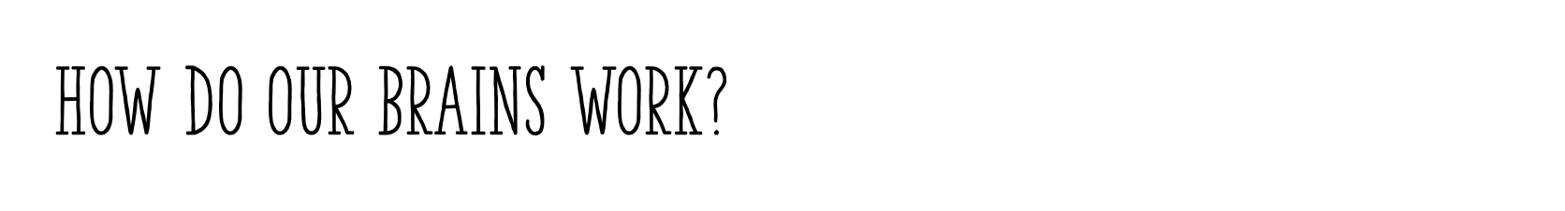
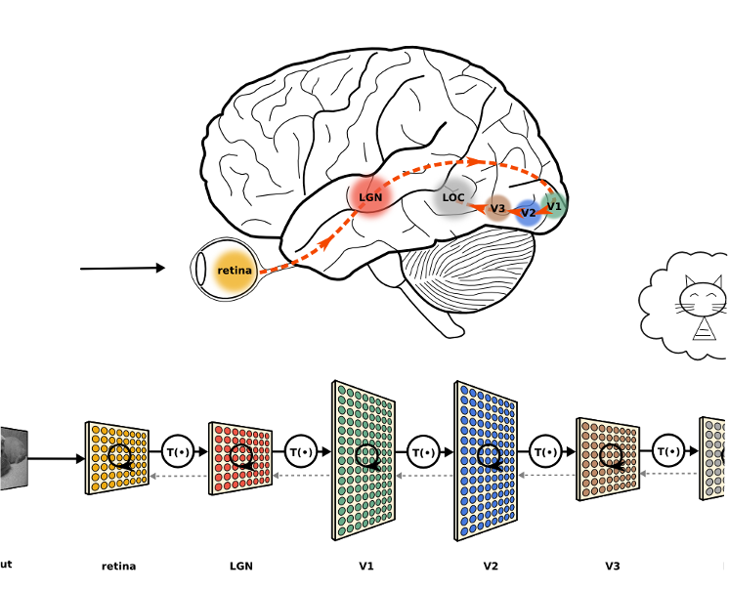
Notes:
And what we going to do w cnn is interesting coz u’ll find that the way computers are going to be processing images is going to be extremely similar to the way our brain processing or even taking over artificial neural networks so a massive increase and is going to keep going that way

Slide 22
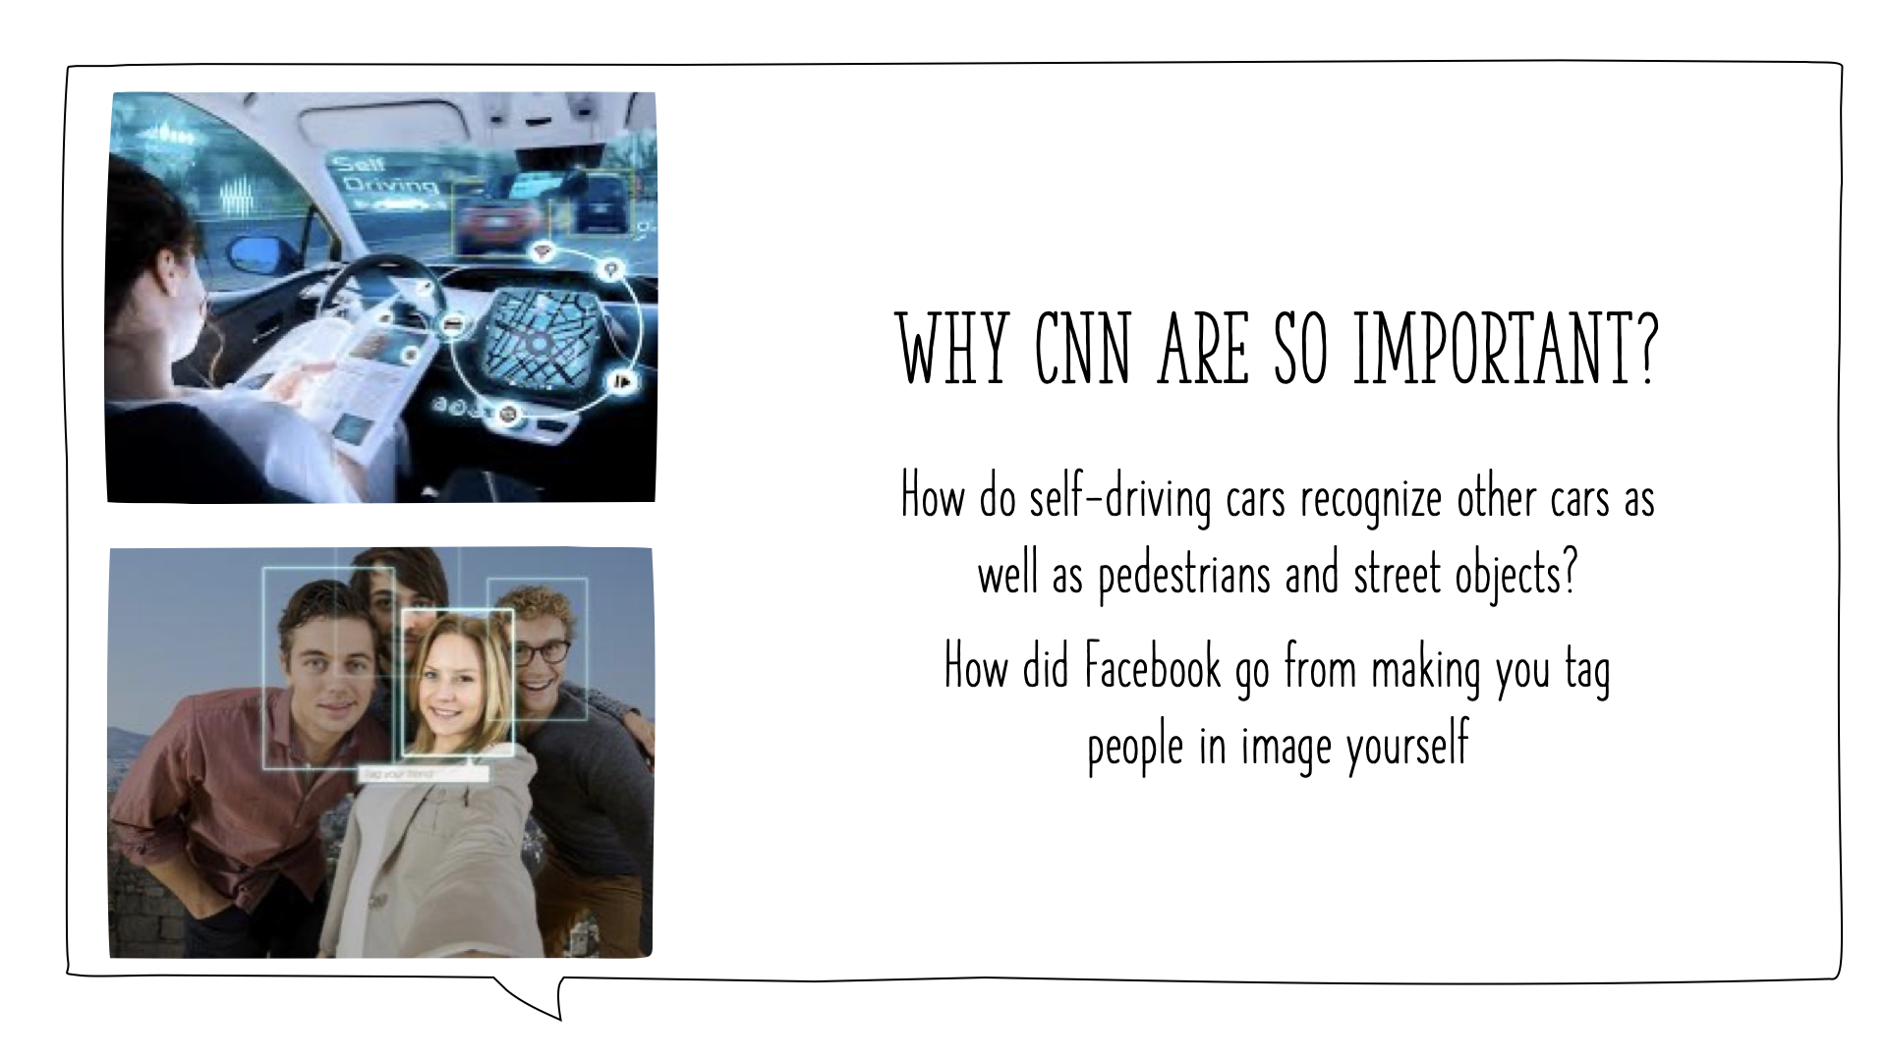
Notes:
To understand this, you can ask yourself a couple of simple questions: where all the things happen such as like self driving cars, how do they recognize people on the road, how do you recognize stop signs and things like that, how does Facebook host able to tag images or people in images and not only just like remember previously years ago you had to tag people yourself then it would recognize faces. you had to add the names and now it just recognizes the faces and adds the names at the same time well.
And the answer to both questions would be: through the magic of convolutional neural networks that we will elaborate later

Slide 23
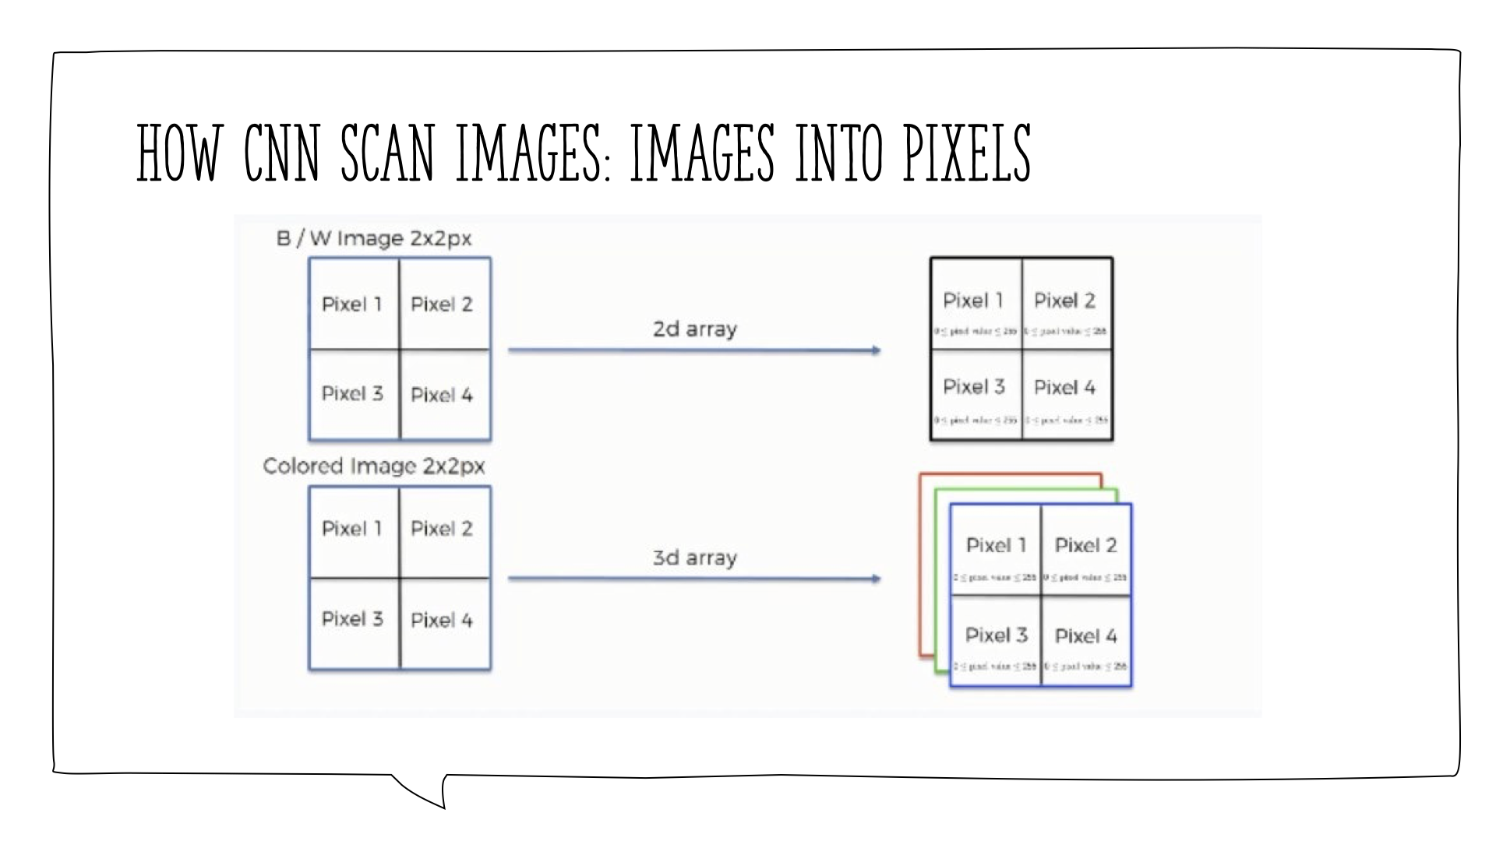
Notes:
Before getting into the details of this operation, you should first keep in mind that the way black & white images are scanned differs in one major way from how colored images are. We're going to examine each of them separately, but first, let's look at the similarities.
Both types of images are similar in the following respects:
•Each pixel contains 8 bits (1 byte) of information.
•Colors are represented on a scale from 0 to 255. The reason for this is that bits are binary units, and since we have 8 of these per byte, a byte can have any of 256 (2^8) possible values. Since we count 0 as the first possible value, we can go up to 255.
•In this model, 0 is pitch black and 255 is pure white, and in between are the various (definitely more than 50!) shades of gray.
•The network does not actually learn colors. Since computers understand nothing but 1's and 0's, the colors' numerical values are represented to the network in binary terms.
Now let's delve into the major difference that we mentioned above.
Black & white images are two-dimensional, whereas colored images are three-dimensional. The difference this makes is in the value assigned to each pixel when presented to the neural network. In the case of two-dimensional black & white images, each pixel is assigned one number between 0 and 255 to represent its shade.
On the other hand, each pixel inside a colored image is represented on three levels. Since any color is a combination of red, green, and blue at different levels of concentration, a single pixel in a colored image is assigned a separate value for each of these layers.
That means that the red layer is represented with a number between 0 and 255, and so are the blue and the green layers. They are then presented in an RGB format. For example, a "hot pink" pixel would be presented to the neural network as (255, 105, 180).

Slide 24
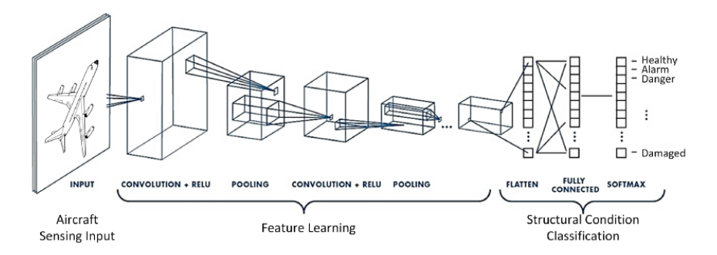

CNN Architecture
Notes:
-These are the CNN architecture you will normally find online, where they have graphical representations for each layer that exist within a CNN architecture

Slide 25
CNN Architecture
Input
Convolution
ReLU
Pooling
Fully Connected
Softmax (Output)
Notes:
-This is the summarised version of the CNN architecture, which is the same as what I show you in the last slide
-Input layer followed by convolution layer…….
-I will explain each layer in depth and therefore by the time when I finish the softmax activation layer which is also the output layer, hopefully you will have a clear understanding on what CNN is and how CNN works

Slide 26
Input Layer

Slide 27

Matrix of pixels with a given Width (W), Height (H), and Channel (C)
Channel Grayscale image channel = 1
RGB image channel = 3
RGB image
Notes:
-Images are a matrix of pixels with a given Width (W), Height (H), and Channel ©
-Colored images are made up of 3 channels RGB
-Grayscale images are made up of 1 channel

Slide 28
Convolution Layer

Slide 29
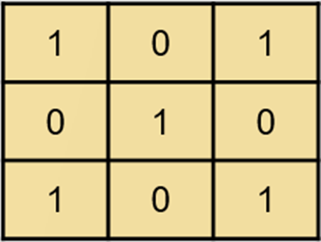
Receptive Field
Portion of space or spatial construct containing units that provide input to a set of units within a corresponding layer
Kernel/Filter
A filter that is used to extract the features from the images.
Kernel sizes consist of 1x1, 2x2, 3x3, 4x4 and 5x5 for 2D Convolution
3x3 kernel
Feature Map/Activation Map
Generated by applying kernels/filters to the input image
Notes:
-Receptive field is a portion of space or spatial construct containing units that provide input to a set of units within a corresponding layer
-The receptive field is defined by the filter size of a layer within a convolution neural network.
-The receptive field is also an indication of the extent of the scope of input data a neuron or unit within a layer can be exposed to
-Kernel or filter is a filter that used to extract the features from the images
-The kernel is a matrix that moves over the input data, performs the dot product with the sub-region of input data, and gets the output as the matrix of dot products.
-When you are training the network, you’re trying to optimise the values of the kernel and the bias associated with it
-Kernel sizes consists of 1x1, 2x2, 3x3, 4x4 and 5x5 for 2D Convolution
-Feature map/Activation map is generated by applying kernels/filters to the input image.
-Output of the dot product between the kernel and the sub-region of the input data

Slide 30

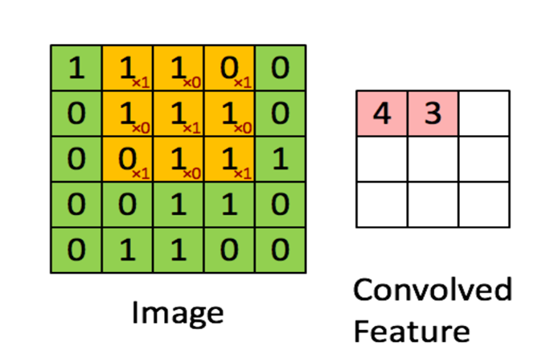
2D Image
Convolution is the process of sliding a kernel/filter across the image
The kernel acts as a feature detector and outputs a feature map (convolved feature)
Parameter sharing on kernels result in a massive reduction in the number of parameters being produced
Convolution operation of a 5x5x1 image with a 3x3x1 kernel to get a 3x3x1 convolved feature
Calculation example
(1x1) + (1x0) + (0x1) + (1x0) + (1x1) + (1x0) + (0x1) + (1x0) + (1x1) = 3
Notes:
-Green pixels are the image
-Yellow pixels with small numbers at the corner are the kernel/filter
-Pink pixels are the feature map
-Convolution is the process of sliding a kernel/filter across the image
-Slide the kernel from left to right and from top to the bottom, then perform dot-product between the kernel and the sub-region of the input data
-The kernel acts as a feature detector and outputs a feature map (convolved feature)
-Calculation example
-There is only one channel where only need to do dot product on that channel, however for 3D image need to do dot product on the 3 channels then add up together, explain more in-depth in the next slide
-Parameter sharing on kernels result in a massive reduction in the number of parameters being produced
-The parameters on the same kernel are the same, different kernel will have different parameters, which will see in the next slide

Slide 31
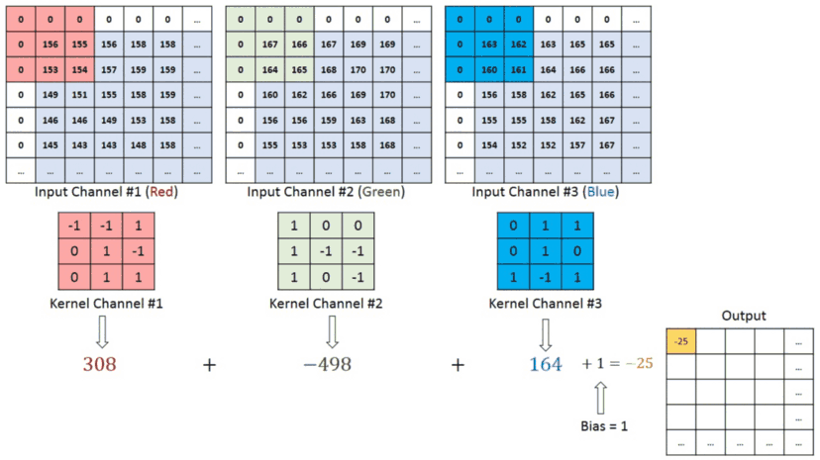
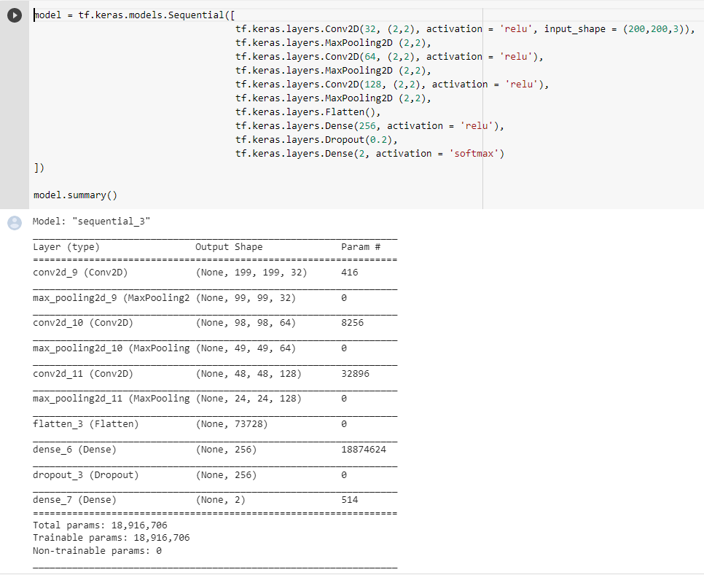
3D Image
Depth of the kernel is set automatically to be equal to the input’s depth
Bias is introduced to eliminate error
Convolution operation of a 5x5x3 image with a 3x3x3 kernel with zero padding to get a 4x4x1 feature map
Kernel size set to 2x2xC where C = channel of input image
With kernel’s depth set to 3 (same as input image), and number of kernel set to 32:
Calculation Example
# of parameter = (2x2x3) x 32 + 32 = 416
Number of biases
Notes:
3D image:
-The most common case you would encounter, where the images contain 3 channels RGB
-How does this work?
-The colored and the moving pixels are the kernels
-Depth of the kernel is set automatically to be equal to the input image depth, you only need to set the height and width of the kernel. What does it mean?
-In this case, we have one kernel sized 3x3. The depth is automatically set to 3 as there are 3 channels in the input image, where it will become shape of 3x3x3
-Perform convolution operation on all 3 channels of the input image using 3 different kernels. Where each channel after the convolution operation will produce one output value. In this case, as we have 3 channels therefore producing 3 output values
-Add up the output values and a bias to become the final value on the feature. This is how a convolution operation works on a 3 channel image
-To understand more on how convolution operation works, we can try looking at a coding example for image classification, then try to calculate how many parameters or weights are produced in a convolution layer
-This is the Convolution Neural Network built using tensorflow library
-Create a convolution layer with 32 kernels, size set to 2x2, notice that we never set the depth of the kernel as it will be automatically set to be equal to the input’s depth
-In this case the depth is set to 3 as our input image has a shape of 3 channels
…
…
-multiply by 32 as we have 32 different kernels. What does this mean? This means that the same convolution operation is applied on the same image 32 times each with different layers
….

Slide 32
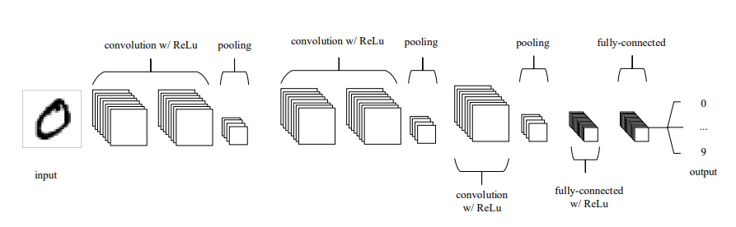
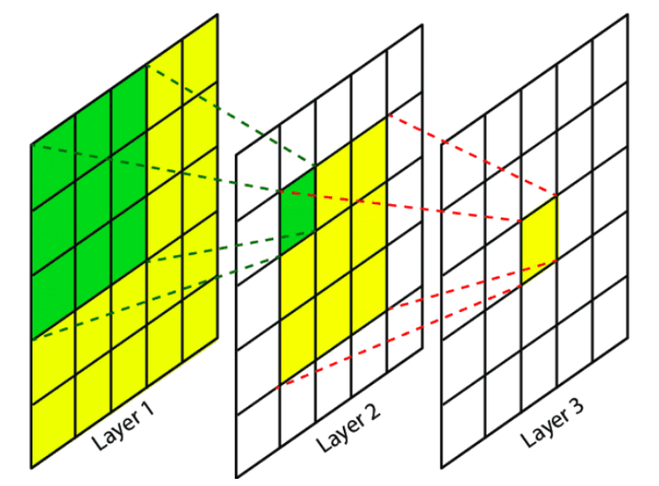
A common form of CNN architecture in which convolutional layers are stacked between ReLus continuously before being passed through the pooling layer
How it works
First conv layer extracts low-level features like edges, lines, curves.
Subsequent layers extract higher level features like shapes, objects etc (hierarchical), since the region of the image within a higher layer are results of the accumulated receptive fields of previous lower layers
A common form of CNN architecture in which convolutional layers are stacked between ReLus continuously before being passed through the pooling layer
Receptive field size = 5x5
Notes:
https://theaisummer.com/receptive-field/
-What’s the logic behind CNN? Why do we call the kernel a feature extractor that it is extracting the features in an object?
-This is a common form of CNN architecture in which convolutional layers are stacked between ReLUs continuously before being passed through the pooling layer
-When we zoom into the convolutional layers we see something like this, that the image undergo convolutional operation multiple times and downsample at every time
-This is the image itself where it contains a digit, and this is the first conv layer, the receptive field size at this pixel here is 3x3
-And how it works is that according to CNN the first layer extracts low-level features like edges, lines and curves
-Then the third layer of the subsequent layers extract higher level features like shapes, objects, etcs because according to CNN the region of the image within a higher layer are a results of the accumulated receptive fields of previous lower layers
-As you can see in this 2nd conv layer at this pixel, the receptive field size is 5x5. Recall that receptive field size is the indication of the extent of the scope of the input image a unit within a layer can be exposed to. This means that this pixel right here is exposed to 5x5 pixels of the input image
-So in our case trying to classify the digit 0, the 1st conv layer is probably extracting information such as edges, lines of the digit 0. And the subsequent layers are trying to extract the shape of the digit 0

Slide 33
ReLU Activation Layer

Slide 34

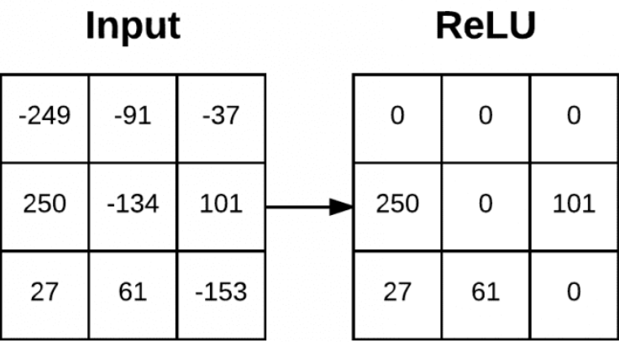
ReLU converts all negative inputs to zero
Therefore, ReLU does not activate all neurons at the same time
This makes it very computational efficient as few neurons are activated per time. Hence ReLU converges faster than other functions like tanh and sigmoid activation functions
ReLU Activation Function
ReLU Activation Function applied on the output from convolution operation
Notes:
https://medium.com/dataseries/basic-overview-of-convolutional-neural-network-cnn-4fcc7dbb4f17#:~:text=The%20activation%20function%20is%20a,neuron%20would%20fire%20or%20not.&text=We%20have%20different%20types%20of,Rectified%20Linear%20Unit%20(ReLU).
-Recall that activation function is nothing but just a function that is applied on the neuron outputs
-In CNN, the most common activation function that we apply after the convolution layer is the ReLU activation function
-So what is ReLU?
-ReLU converts all negative inputs to zero
-Look at this graph over here, all the inputs z that are in negative values will change to 0 after ReLU, and the other +ve input values z will just remain the same
-This is because ReLU is nothing but a function that is equal to the maximum between 0 and the the z value itself where the z value is positive
-So ReLU is applied on the output or the feature map after the convolution operation on the element wise basis. This is the example
-And you will probably ask why do we choose ReLU?
-The reason we choose ReLU is because ReLU does not activate all neurons at the same time
-This makes it very computational efficient as few neurons are activated per time. Hence ReLU converges faster than other functions like tanh and sigmoid activation functions
-So what does this mean?
-So there is this process called the back propagation process, which can be another topic so i wont be discussing too much details today
-But this is basically a process trying to optimise the loss functions in the cnn to update the weights and biases by calculating the gradient of loss function against the weights
-As the gradient of the Relu at the negative side of the graph is zero. Due to this reason, during the backpropagation process, the weights and biases for some neurons are not updated. Therefore more computrational efficient

Slide 35
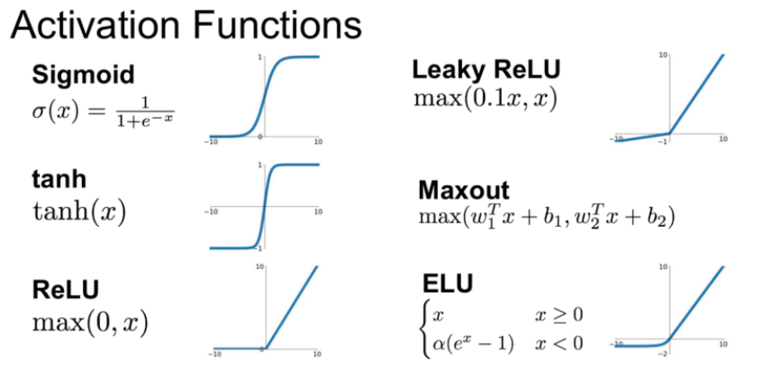
Other Activation Functions

Slide 36
Pooling Layer

Slide 37

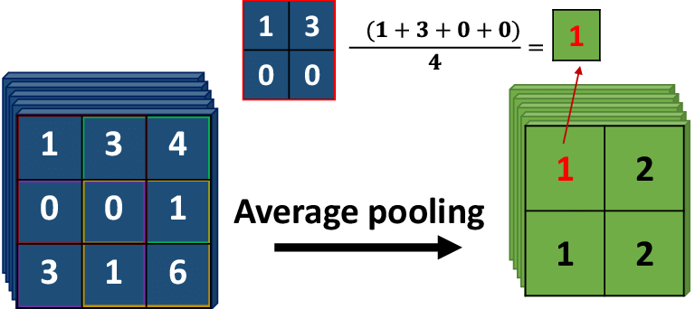
Max Pooling
Pooling layer is responsible for reducing the spatial size of the feature map
Max Pooling
Returns the maximum value from the portion of the image covered by the kernel
Performs as noise suppressant
Typically done in the middle of CNN
Average Pooling
Returns the average of all the values from the portion of the image covered by the kernel
Typically used as the final layer before fully connected layer
3x3 max pooling over 5x5 feature map
Average Pooling
2x2 average pooling over 3x3 feature map
Notes:
-Pooling layer is responsible for reducing the spatial size of the feature map
-There are mainly two types of pooling we often use, max pooling and average pooling
-For pooling, we have the kernel sliding across the input image however without parameters inside it
-For max pooling we often have a 2x2 or 3x3 kernel that slide across the input image, and it returns the maximum value from the portion of the image covered by the kernel and be used as a feature map value
-As you can see here, the green ones are the kernels and it is performing a 3x3 max pooling over a 5x5 feature map here. It is selecting the biggest value in the kernels to be used as the new feature map value
-Few things to take note here, the advantage of performing a max pooling is that it performs as a noise suppressant as some values in the feature map are not ignored and not used in the subsequent layers
-And we typically place max pooling in the middle of CNN
-For average pooling, the name itself is pretty self-explanatory
-Instead of choosing the maximum number, it returns the average of all the values from the portion of the image covered by the kernel
-The difference is that average pooling layer is typically placed in the final layer of CNN before the fully connected layer

Slide 38
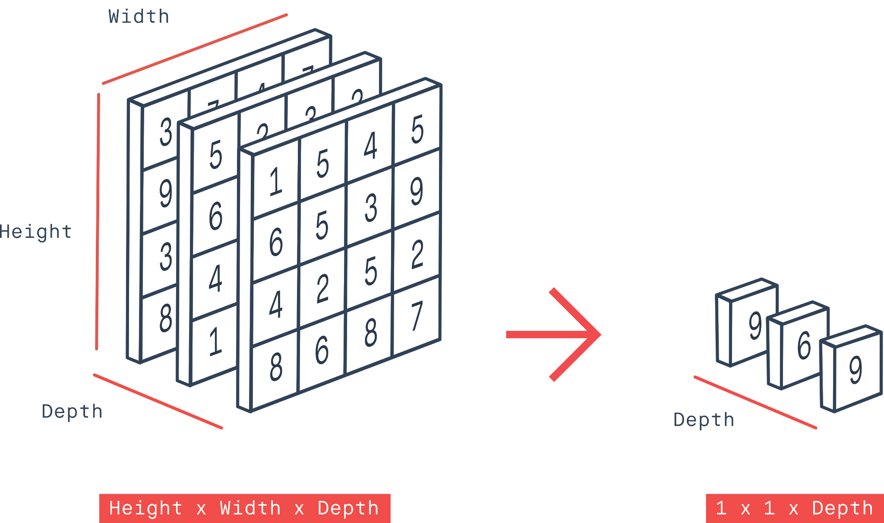
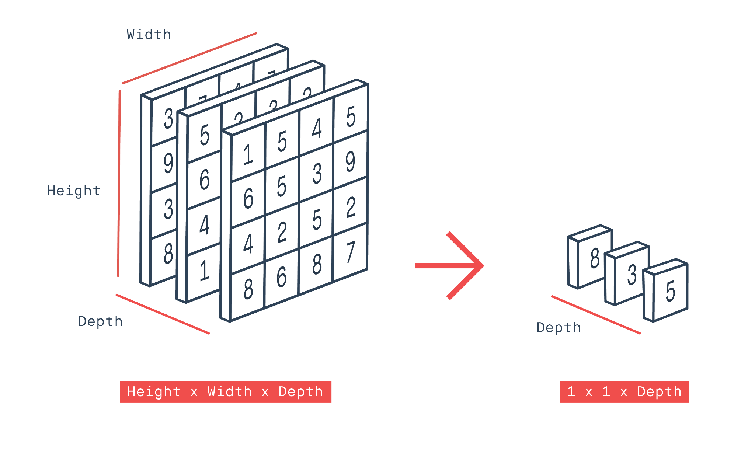
Global Max Pooling
Global max pooling = ordinary max pooling layer with pool size equals to the size of the input
Global average pooling = ordinary average pooling layer with pool size equals to the size of the input
Designed to replace the fully connected layers
Resulted vector is directly fed into the softmax layer
Advantages include:
Overfitting is avoided
Dimensionality reduction, therefore more robust to spatial translation of the inputs
Global max pooling over 4x4x3 feature map to produce 1x1x3 output
Global Average Pooling
Global average pooling over 4x4x3 feature map to produce 1x1x3 output
Notes:
-There is also global max pooling global average pooling where the only difference between these 2 and the previous 2 is that over here, the kernel size is set to be equal to the size of the input
-They are designed to replace the fully connected layers as the output is only 1 value after performing these pooling operations
-The resulted vector will be directly fed into the softmax layer to be used for classification purpose, which we will talk more about this layer later
-Some advantages of these two pooling operations are that overfitting is avoided as there is more dimensionality reduction as more pixel values are ignored, therefore more robust to spatial translation of the inputs. The model will be more robust.

Slide 39
Fully Connected Layer

Slide 40
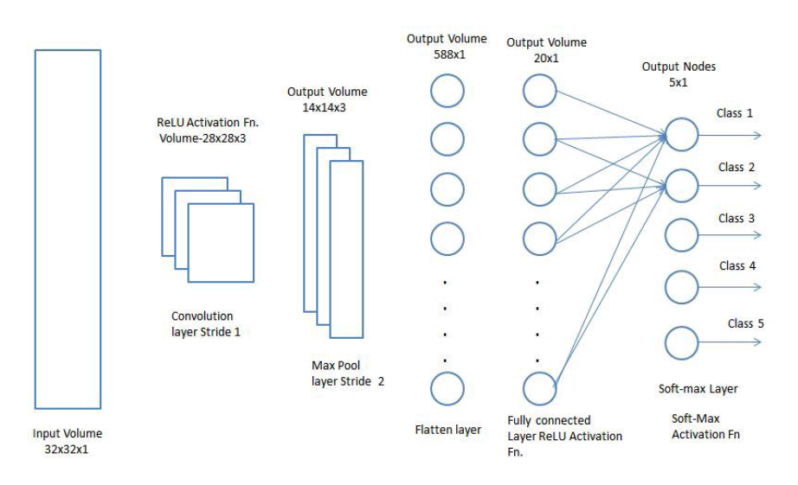

Fully connected layers have the same architecture as ANNs
Acts as classifier
Fully connected layers expects a 1D vector of numbers
Therefore output from the previous pooling layer is flattened before passing into FC. However, spatial information would be discarded.
Activation functions such as ReLU are used in the hidden layers to introduce non-linearity into the layers
Flatting of matrix into 1D vector before passing into FC layer
Notes:
-Fully connected layers act as the classifier.
-This means that at the end of fully connected layer, after passing through softmax max activation function, it will produce probabilities on each class of the image you are trying to classify
-So how does fully connected layer do that?
-First of all, fully connected layers have the same architecture as ANNs as Minh Anh has mentioned just now
-A fully connected layer expects a 1D vector of number, and remember after our pooling layer we still have a 2D matrix of images. Therefore the first thing we have to do before passing the matrix into the fully connected layer is to flattened the output from the previous pooling layer. However, do note that in this way spatial information would be discarded.
-After the matrix has been flattened and passed into the fully connected layers as the input layer, we will calculate the weighted sum for each node in the hidden layer as what Minh Anh has mentioned just now
-After several hidden layers in the fully connected, we will finally pass the weighted sums into the softmax activation layer to produce probabilities, where again I’ll explain in the next slide.
-One thing to take note is that the activation functions such as ReLU are used in the hidden layers too to introduce non-linearity into the layers

Slide 41
Softmax Activation Layer

Slide 42

This is to normalise the scores for comparison when classifying objects
Softmax converts logits (L) into probabilities that sum up to 1
Softmax Activation Function
Notes:
https://towardsdatascience.com/softmax-activation-function-how-it-actually-works-d292d335bd78
-Since the weighted sum of our output in the fully connected layer has a very large range from very large -ve numbers to very large +ve numbers
-We need to normalize these values in order to be used for comparisons when classifying images and the objects -Softmax converts logits (L) which are the values from the output layers into probabilities, and since they are probabilities, when we add all the probabilities up in the output they should sum up to 1]\
-Softmax function is nothing but a function equals to this formula:
-zi refers to the corresponding output value at position i in the output layer. For example, for probability 0.02 the corresponding zi would be 1.3. Therefore e power 1.3 is the numerator
-The denominator of the softmax is just the summation of all the e to the power z, where z is the value from the output layer
-With this, I’ve done the architecture of CNN.
-Next, I am going to explain several techniques that are commonly used in CNN, which are the stride and the padding.

Slide 43
Stride, Padding and Output Size

Slide 44
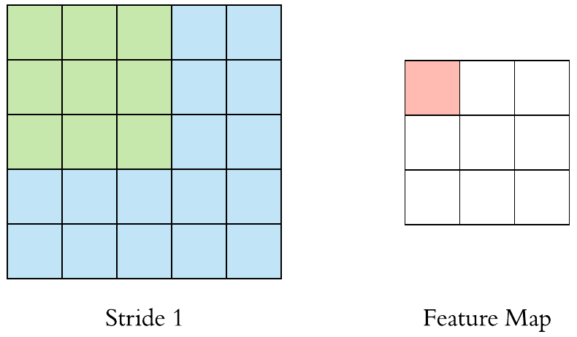
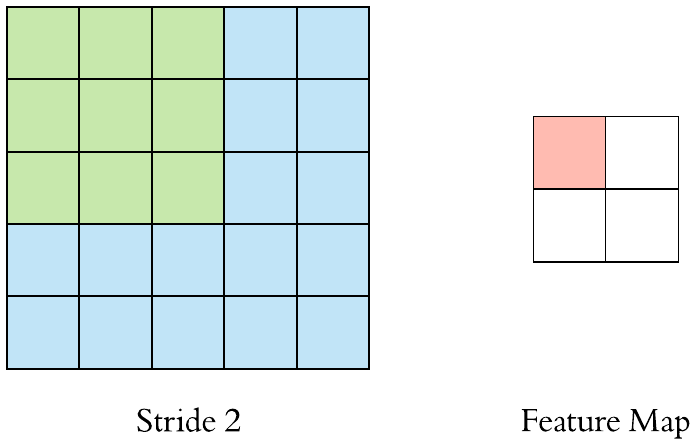
Stride
Stride specifies how much we move the convolution filter at each step
Smaller stride produce heavily overlapped receptive field with extremely large feature map
Larger stride will reduce the amount of overlapping and produce an output of lower spatial dimensions.
Stride of 1 in CNN
Stride of 2 in CNN
Notes:
-First one, stride or striding.
-What is stride?
-Stride specifies how much we move the convolution filter or kernel at each step during convolution layer and pooling layer
-This is an example of stride of 1 in CNN, where the kernel does not skip any pixel when moving from left to right and from top to bottom
-Whereas in the stride of 2 in CNN, the kernel skips one pixel when moving from left to right and top to bottom -And if you notice, in the previous slide when I was talking about the convolution layer and the pooling layer, it was mostly using a stride of 1(scroll back to pooling layer slide and conc layer slide)
-Different number of strides have different advantages
-Smaller stride produce heavily overlapped receptive field with extremely large feature map. In this way the size of the feature map output is reduced in a slower speed, therefore you will have enough weights and biases before the images becomes very small.
-Conversely, larger stride will reduce the amount of overlapping and produce an output of lower spatial dimensions. This means that the size if the feature will be reduced in a faster speed as some input pixels are ignored. Therefore through larger stride you can also produce a more robust model
-It is through trial and error to determine which number of stride is best suited for your model

Slide 45
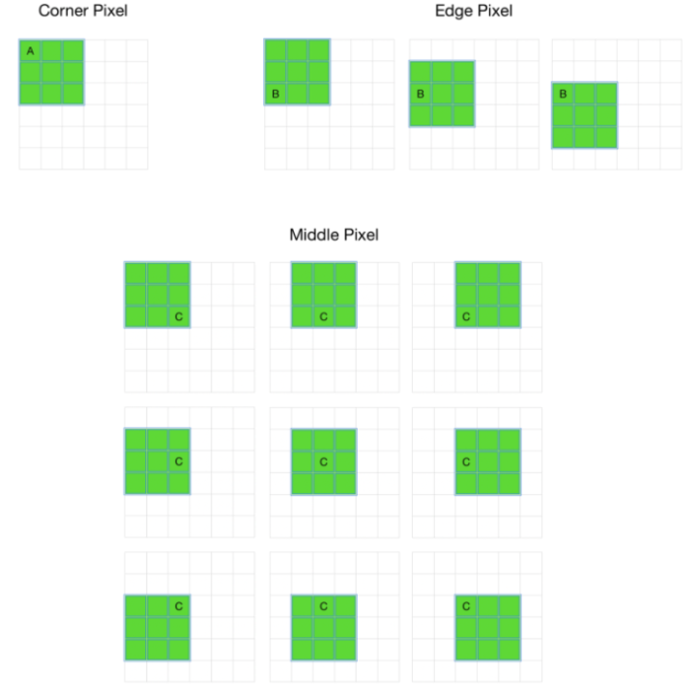
Padding
Padding extends the area of an image in which a convolutional neural network processes
Filters we are using do not focus on the corners and edges every time it moves on the pixels, this will cause loss of information available
To solve this problem, we use padding
Types of padding:
Same padding
Valid padding
Causal padding
Pixel A and pixel B are not focused as much as pixel C
Notes:
https://analyticsindiamag.com/guide-to-different-padding-methods-for-cnn-models/
-Next one, padding.
-Padding extends the area of an image in which a convolutional neural network is applied
-The main reason we use padding is because during the convolutional neural network operation, the filters we are using do not focus on the corners and edges every time it moves on the pixels, this will cause loss of information available.
-For example, pixel A at the corner of the input image. This corner pixel A is coming under the filter in only 1 movement. The edge pixel B is coming in only in 3 movements
-Whereas pixel C that are neither corner pixel or edge pixels come under the filter in 9 times.
-This indicates that the corner and edge pixels are not as prioritised in the CNN, and we do not want that as sometimes the corner and edge of the input image contains important information that we want to capture
-Therefore to solve this problem we use padding
-There are mainly 3 types of padding, and I am only going explain the more common ones which are the same padding and valid padding

Slide 46
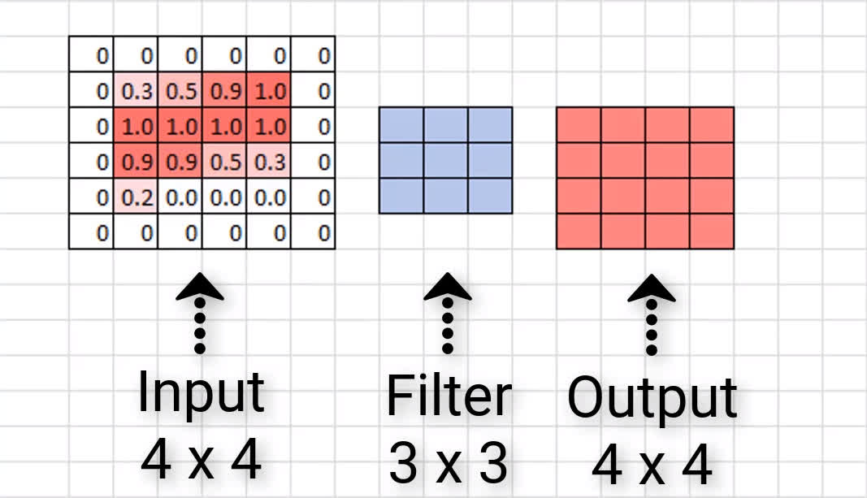
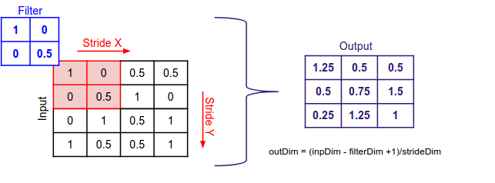
Padding
Same padding
Same padding
Add zeros to the border of the image such that the output image has the same dimensions as the input image
Valid padding
Implies no padding at all, output image size is reduced
Valid padding
Notes:
-First same padding
-What does it mean?
-It means we pad the input with zeros to the border of the image such that the output image has the same dimensions as the input image
-This has the advantage that the input size will not reduce very fast.
-Second the valid padding
-Valid padding just simply implies that there is no padding at all, therefore the output image is reduced.
-We don’t apply padding here but we assume that every pixel of the image is valid so that the input can get fully covered by the filter

Slide 47
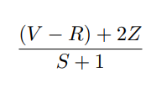
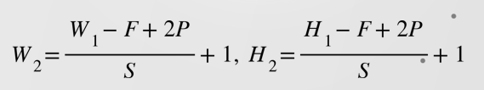
v
Output size
To verify if stride has been set correctly:
Output size:
Where V = input volume size (HxWxC)
R = receptive field size
Z = amount of zero padding
S = stride
If calculated result is non-integer, then stride has been set incorrectly
Where W, H = input size
F = kernel size
S = stride
P = padding
Notes:
-Finally, here are just some mathematical formulas you can use after applying stride and padding
-First formula is used to verify if stride has been set correctly, if the output result is not an integer, that means your stride has been set incorrectly
-Second formula is to calculate the output size of the feature map, W and H after you have applied stride and padding

Slide 48
Image Classification in Google Collab!
Notes:
Classification of five classes flowers:
https://colab.research.google.com/drive/18-4-00xhSqYLPV2bEPDgJNpXDVmvhyJ4?authuser=1#scrollTo=WcUTyDOPKucd
-With this we have concluded the theoretical explanation of the what is CNN and how CNN works
-Now let’s try to look into a simple image classification model in Google Collab that we use to classify 5 different classes of flowers

Slide 49


Where do we start?
Pytorch or Tensorflow?
Resources?
Books
Hands-On Machine Learning with Scikit-Learn, Keras, and TensorFlow, 2nd Edition
Pattern Recognition and Machine Learning, Christopher M. Bishop
Online courses/Youtube
Stanford CS231n: Deep Learning for computer vision
Corey Schafer/Digital Sreeni (Youtube channel)
Kaggle, Github, Coursera, Udemy
Research papers
Projects recommendation?
Image Classification using EfficientNet/ResNet
Face Recognition using OpenCV
Real-time objection detection with YOLOv3, YOLOv4, YOLOx
Notes:
Classification of five classes flowers:
https://colab.research.google.com/drive/18-4-00xhSqYLPV2bEPDgJNpXDVmvhyJ4?authuser=1#scrollTo=WcUTyDOPKucd
-With this we have concluded the theoretical explanation of the what is CNN and how CNN works
-Now let’s try to look into a simple image classification model in Google Collab that we use to classify 5 different classes of flowers

Slide 50

https://bit.ly/3RajHCU
Thank you!
https://bit.ly/3RajHCU
Please do our feedback form so we can improve our future workshops!
Follow us on Instagram (@mlda_at_eee_ntu) and LinkedIn to stay up to date with our activities!

